Slide 1
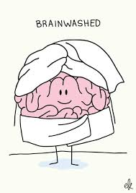
Stimulus and Receptors

Slide 2
Sensory receptors detect stimuli
A stimuli is a change that occurs in the internal or external environment e.g. temperature, pain, pressure, light

Slide 3
Receptors
Type of receptor | Stimuli detected | Where in the body
Mechanoreceptor Meissner’s corpuscle Pacinian receptor | Touch, pressure and vibrations (sound) | Finger tips, hair cells in the ear
Chemoreceptor | Chemical substances | Taste buds, nose cells
Thermoreceptor | Temperature | Skin, hypothalamus
Photoreceptor | Light | Retina of the eye
Nociceptors | Pain | Skin

